Slide 1

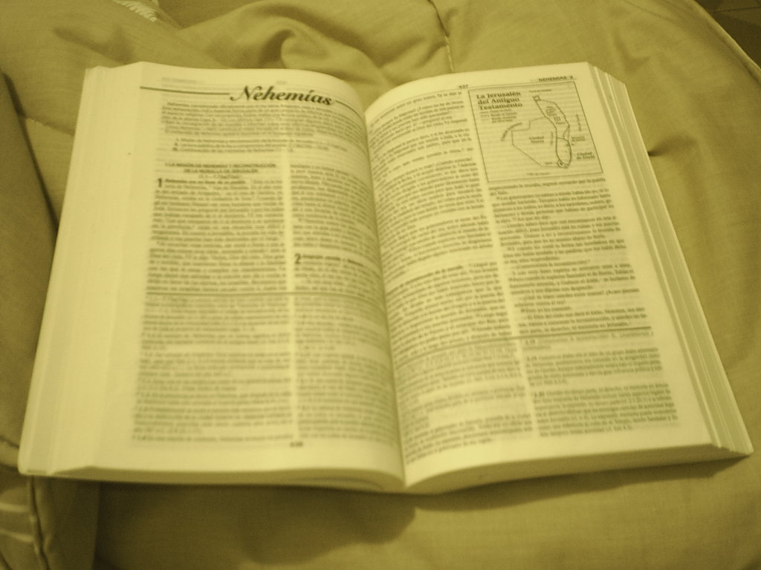
Comunicación y Gerencia
To Prosper In A Troubled Land
Deuteronomy 6:1-9

Slide 2
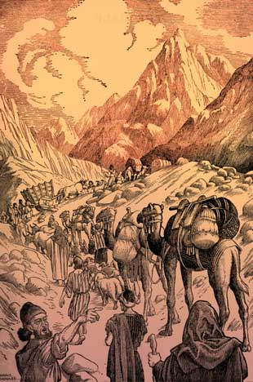
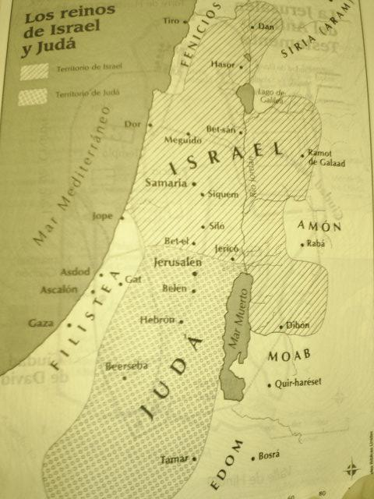
To Prosper In A Troubled Land
(Deuteronomy 6)
Fear The Lord. Verse 2
Stand in awe of Him.
Proverbs 1:7; Hebrews 12:28
Why?
Power in Creation.
Genesis 1:1; Psalms 33:9
Made us in His Image. cf. Acts 17:26-28

Slide 3
To Prosper In A Troubled Land
(Deuteronomy 6)
Moses commanded “That thou mightest fear the Lord thy God.” Deuteronomy 6:2
It is my purpose. Ecclesiastes 2:3; 12:13-14
We must learn. cf. Daniel 4:17,25,32
Early Christians learned. cf. Acts 9:31

Slide 4
To Prosper In A Troubled Land
(Deuteronomy 6)
Realize the power of sin. Verse 3
  Need for commandments. 6:24; cf. 5:33
  What sin does. Isaiah 59:1-2; cf. Numbers 14:22-32
  Warning for us. cf. Hebrews 3:12-19; 4:1;
  cf. 1 Corinthians 10:1-12
  Sin kills. Romans 3:23; 6:23; James 1:12-14
  Sin costs. Isaiah 53; Hebrews 2:9; Romans 3:23-26
  Sin identified. 1 John 3:4; James 4:17

Slide 5
To Prosper In A Troubled Land
(Deuteronomy 6)
Love and trust the Lord. Verses 4-5;
cf. Matthew 22:37; Proverbs 3:5
“With all thy heart” … with all your faculties or powers, and affections … willing to give up all that we hold dear at His command. cf. Matthew 10:34

Slide 6
To Prosper In A Troubled Land
(Deuteronomy 6)
Love and trust the Lord. Verses 4-5;
cf. Matthew 22:37
“With all thy soul.” Or, with all your “life.” Be willing to give up life to Him, and to devote it all to His service; to live for Him, and to be willing to die if necessary. cf. Acts 20:24; 21:13

Slide 7
To Prosper In A Troubled Land
(Deuteronomy 6)
Love and trust the Lord. Verses 4-5;
cf. Matthew 22:37
“With all thy mind.” To submit the “intellect” to His will. To love His law (Psalms 19) more than we do the decisions of our own minds. To be willing to submit all our faculties to His teaching and guidance, and to devote to Him all our intellectual attainments and all the results of our intellectual efforts.

Slide 8
To Prosper In A Troubled Land
(Deuteronomy 6)
Love and trust the Lord. Verses 4-5;
cf. Matthew 22:37
“With all thy strength” (Mark). With all the faculties of soul and body. To labor and toil for His glory, and to make that the great object of all our efforts. (Barnes’ Notes)

Slide 9
To Prosper In A Troubled Land
(Deuteronomy 6)
Know the will of God. Verses 6-7; Exodus 12;
Joshua 4
  We need to know. Acts 17:11; cf. Matthew 22:29ff
  Teaching necessary. Matthew 28:19; Hosea 4:6;
  John 6:44-45; Matthew 11:28
  Study necessary. 2 Timothy 2:15; 2 Peter 1:3-5;
  cf. 1 Corinthians 1:18ff; Romans 1:16-17;
  cf. John 8:32

Slide 10
To Prosper In A Troubled Land
(Deuteronomy 6)
Keep His commandments. Verse 2
  Must obey. Matthew 7:21-23
  Saving faith. James 2:14ff; Hebrews 11
  Proof of love. John 14:15
  Deuteronomy 6:1-2, “Now this is the commandment, the statutes … that ye might do … to keep all his statutes and his commandments …”

Slide 11
To Prosper In A Troubled Land
(Deuteronomy 6)
Keep His commandments. Verse 2
Through obedience …
  We “purify our souls” 1 Peter 1:22
  We are “made free from sin” Romans 6:16-18
  Hebrews 5:9, “He became unto all them that obey him the author of eternal salvation”
  John 5:3, “For this is the love of God, that we keep his commandments” cf. 1 John 2:1ff

Slide 12
To Prosper In A Troubled Land
(Deuteronomy 6)
As strangers and pilgrims …
  Fear the Lord.
  Recognize what sin will do to us.
  Love the Lord.
  Learn His will AND …
  DO IT !

